Slide 1
Gifted and Talented Secondary Selective Entrance programs
Parent information evening for the 2024 intake
Gifted and Talented Selection Unit

Slide 2
We begin by acknowledging the Traditional Owners of the land on which we meet today. We also pay our respects to Elders past, present and emerging.
We acknowledge and understand that Elders, parents, families and communities are the first educators of their children and we recognise and value the cultures and strengths that Aboriginal children bring to the classroom. Aboriginal people have a long tradition of teaching and learning through sharing their connections with country, community, language and culture, and through their oral histories, stories and lived experiences that are passed from generation to generation. We recognise and value the learning that Aboriginal children bring with them from their homes and communities into the classroom.

Slide 3
Presentation overview
Programs
How to apply
Testing processes
Results
Offers of placement
Key dates

Slide 4
Different programs in public high schools
School-based programs
    school selected and funded
    local intake students only
UNLIMITED
Unlimited
2. Specialist programs
    school selected and funded
    Department endorsed
    local and potential for outside intake
    education.wa.edu.au/specialistprograms
OVER 100 IN WA
3. Gifted and Talented Secondary Selective Entrance
    Department selected and fully Government funded
    selected students from WA, interstate and overseas applicants
    no advantage for local intake
24 IN WA & ONLINE

Slide 5
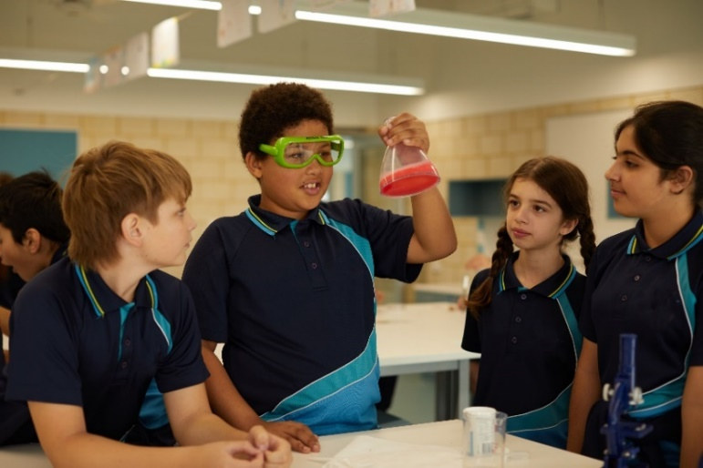
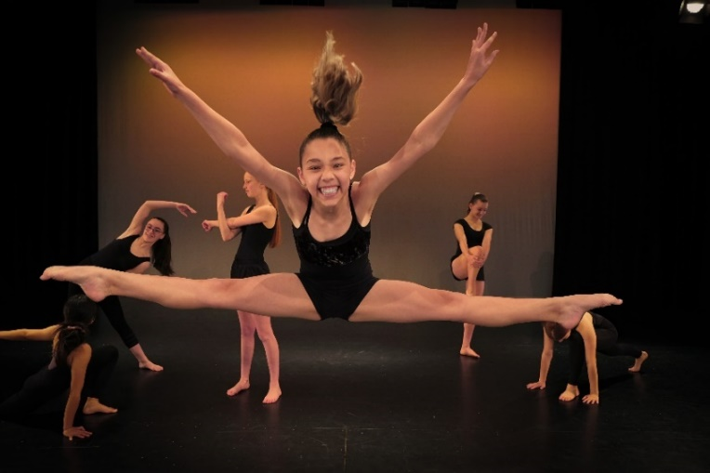
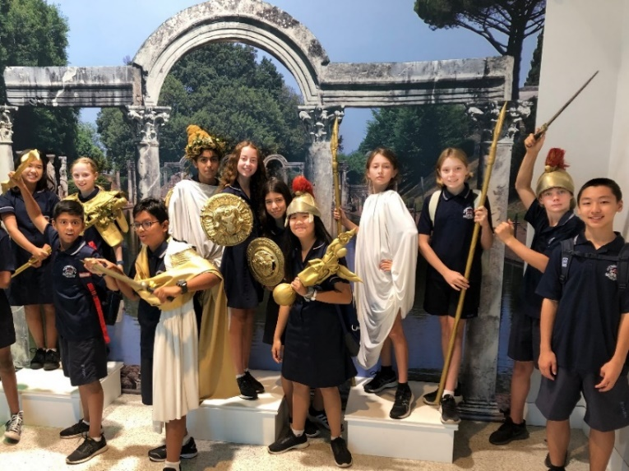
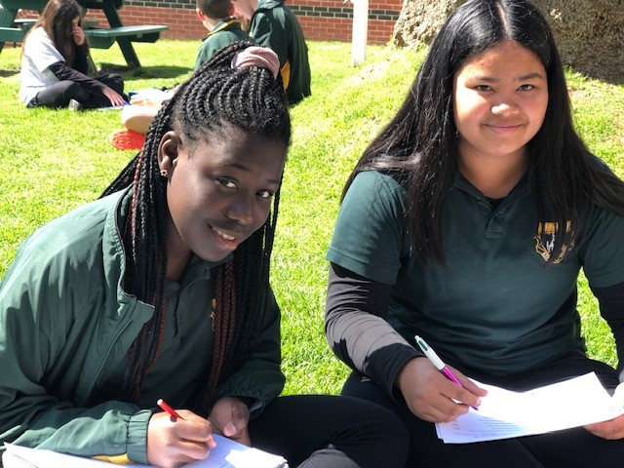
Types of Gifted and Talented programs
  Academic
  Arts
  Languages

Slide 6
Academic programs
Fully selective school
Partially selective schools
Regional online program

Slide 7
Academic programs – fully selective school
Perth Modern School
  Up to 225 places at the start of Year 7 for selected students only
  No local catchment intake
  Testing for vacancies in Year 9
  Up to 25 additional places made available for Year 10 and 11 entry
  Boarding available at City Beach Residential College

Slide 8
Academic programs – partially selective schools
Metro host schools:
Alkimos College
Bob Hawke College
Carine SHS
Comet Bay College
Duncraig SHS
Ellenbrook SC
Fremantle College
Governor Stirling SHS
Harrisdale SHS
Kelmscott SHS
Melville SHS
Shenton College
Willetton SHS
Regional host schools:
Albany SHS (boarding available at Albany Residential College)
Bunbury SHS
  Between 32 and 64 places at the start of Year 7 for selected students
  Students grouped for Mathematics, Science, English and Humanities and Social Sciences (HASS)
  Local intake for non-selected students
  Testing for vacancies in Years 9, 10 and 11

Slide 9
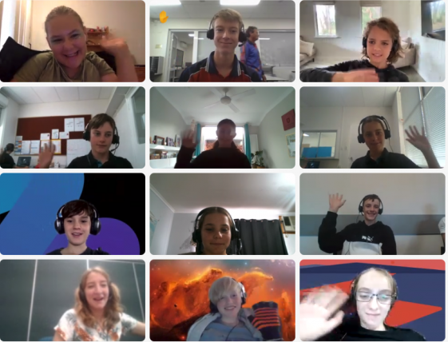
Academic programs – regional online
Selective Academic Program online
  Operates out of any regional public high schools (excluding Albany and Bunbury region)
  Uses computer links and innovative technology
  Unlimited vacancies for entry in years 7, 9 and 10
  Maths/Science, English/HASS or both

Slide 10
Arts programs
Arts college
Partially selective schools

Slide 11
Arts programs – arts college
John Curtin College of the Arts
  Up to 240 places at the start of Year 7 across six arts programs:
    Dance (contemporary and classical ballet) – 50 places
    Drama – 75 places
    Music Theatre – 25 places
    Media Arts – 25 places
    Visual Arts – 25 places
    Music – 40 places
  Students grouped in their arts program classes
  Small local catchment intake and Specialist Soccer program
  Testing for vacancies in Years 9, 10 and 11
  Boarding available at City Beach Residential College

Slide 12
Arts programs – partially selective schools
Contemporary Dance:
Hampton SHS – 32 places
Music:
Churchlands SHS – 50 places
Visual Arts:
Applecross SHS – 28 places
Balcatta SHS – 32 places
Kalamunda SHS - 32 places
  Places vary depending on the program at the start of Year 7 for selected students
  Students grouped in their arts program classes
  Local intake for non-selected students
  Testing for vacancies in Years 9, 10 and 11

Slide 13
Languages programs
Partially selective schools

Slide 14
Languages programs – partially selective schools
Rossmoyne SHS:
Chinese (Mandarin)
French
German
Japanese
40 combined places
Mount Lawley SHS:
Chinese (Mandarin)
Italian
32 combined places
  Students grouped in their languages program classes
  Local intake for non-selected students
  Testing for vacancies in Years 9 and 10 – must have specific language experience

Slide 15

Apply online education.wa.edu.au/gifted-and-talented

Slide 16

Key dates and application guidelines
Click ‘Learn more’ to view the key dates and Applicant Guidelines

Slide 17
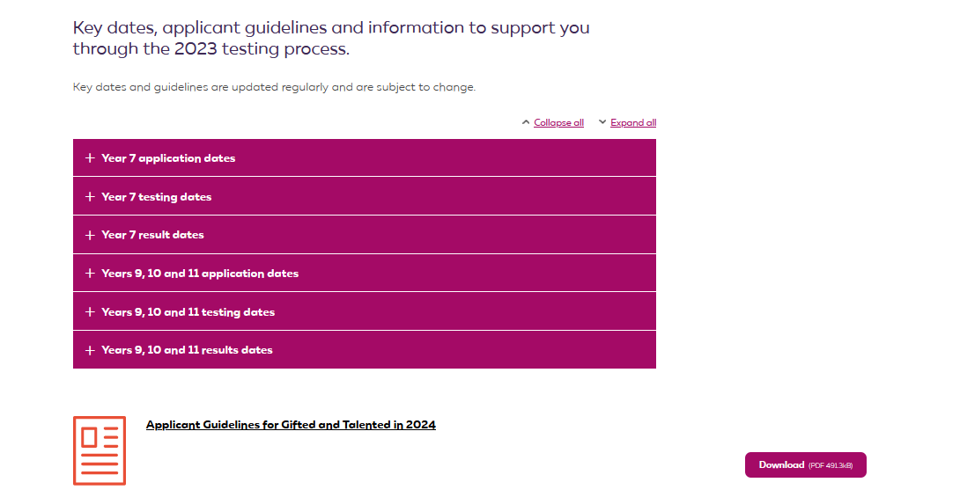

Key dates and application guidelines

Slide 18
Video guides for parents and students
Videos are available to support parents and children through the application, testing and results processes:
Adding Preferences to Your Child’s Gifted and Talented Application
Academic Selective Entrance Test (ASET) – A Guide for Students
How the Offers Process Works

Slide 19
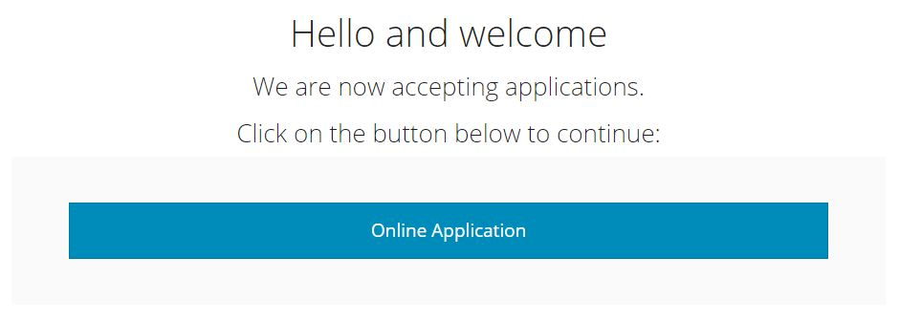
Lodging an application for entry in 2024

Slide 20
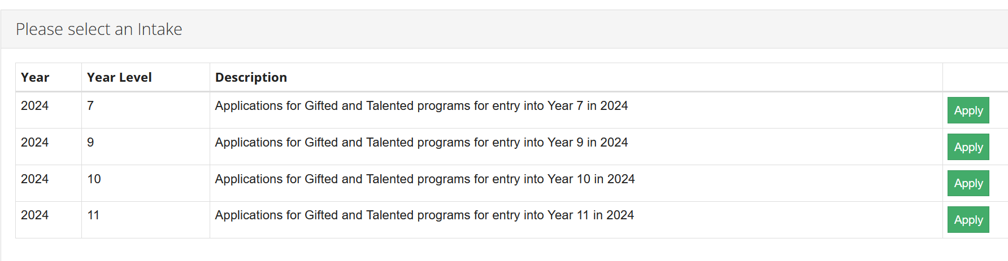
Lodging an application for entry into 2024

Slide 21
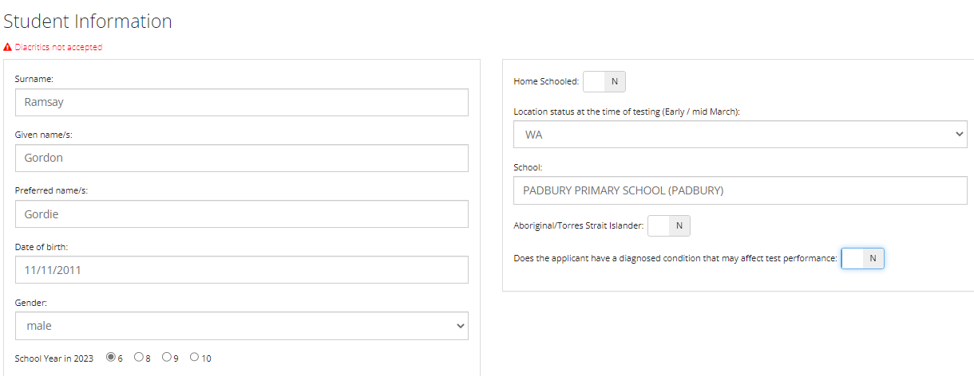
Details about your child
Overseas/interstate testing is available. Children outside of WA will need to show evidence of their enrolment to qualify for overseas/interstate testing.
WA, interstate or overseas testing?
Test venues are allocated based on your child’s school.
School in 2023.
If your child is home schooled or you are overseas/interstate and will be travelling to WA
for the test, please enter the closest school
Yes
Click ‘YES’ to go to the next screen for information on supports available for children with a disability, chronic illness or impairment which may affect their test performance

Slide 22
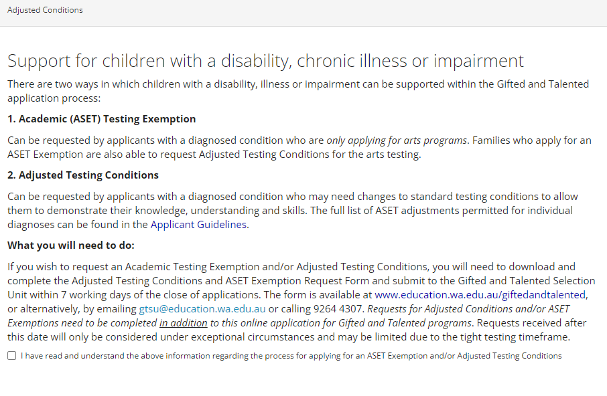
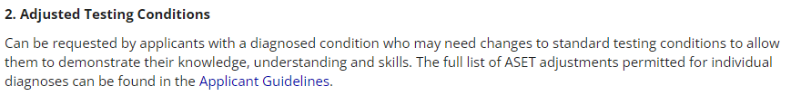
Adjusted Testing Conditions and ASET Exemptions

Slide 23
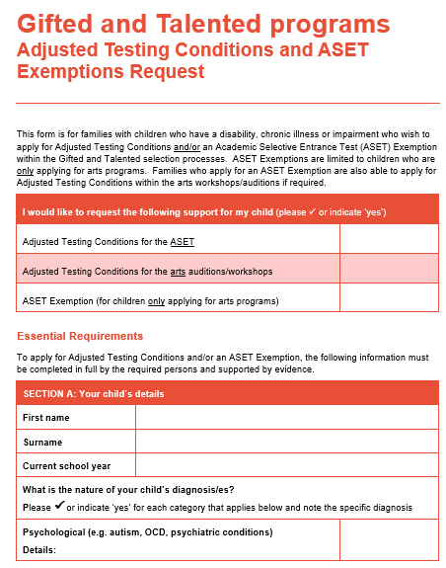
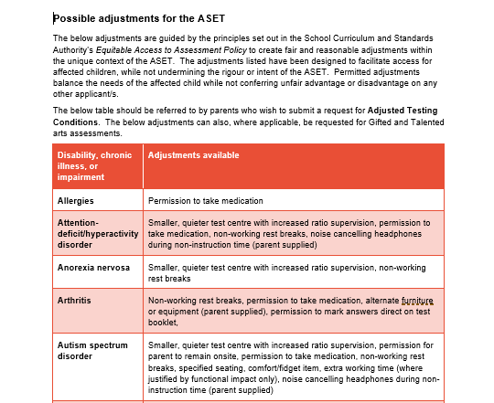
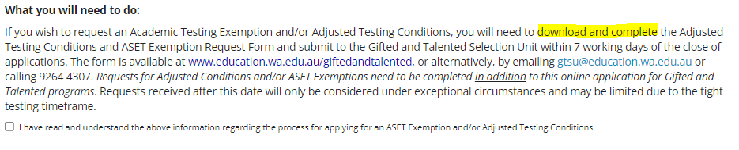

Adjusted Testing Conditions and ASET Exemptions
You will need to tick this box to acknowledge you have read and understand the information provided
The full list of possible adjustments you can apply for on the basis of your child’s condition is on our website and in the Applicant Guidelines.

Slide 24
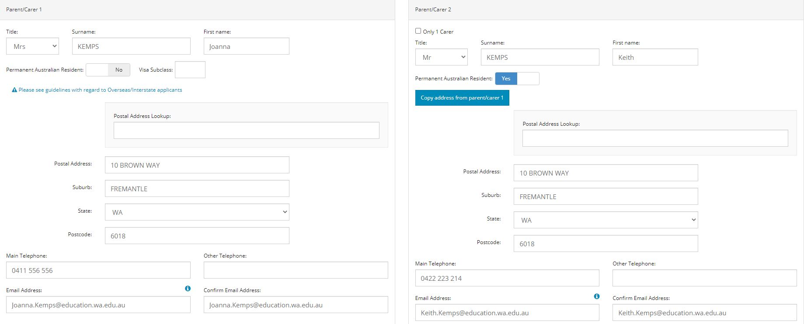

Parent/carer contact information
Applicants must adhere to guidelines for overseas and interstate applicants outlined within the Applicant Guidelines.
All email notifications automatically sent to BOTH email addresses

Slide 25
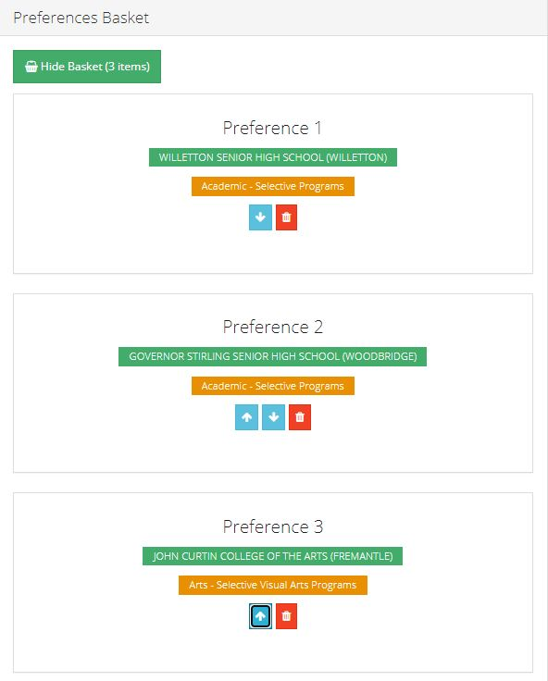
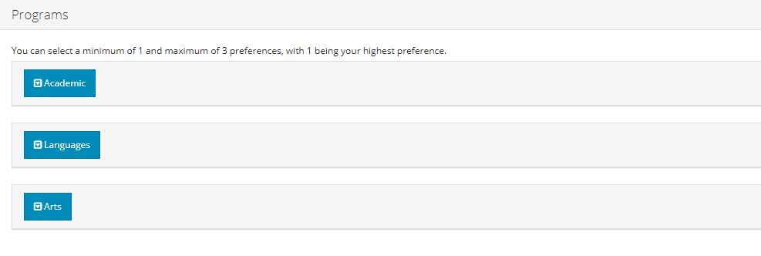
Selecting preferences
YOU MAY SELECT UP TO THREE PREFERENCES ACROSS ALL PROGRAMS
Your preferences will determine the testing your child will be invited to participate in.
No testing = no potential for placement.

Slide 26
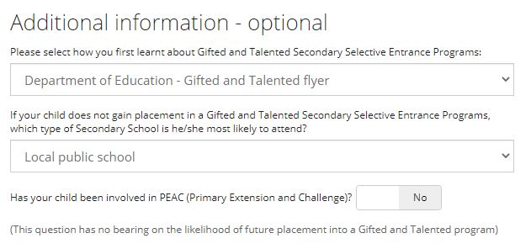
Additional information
Statistical questions only,
answers have no bearing
on your child’s application

Slide 27
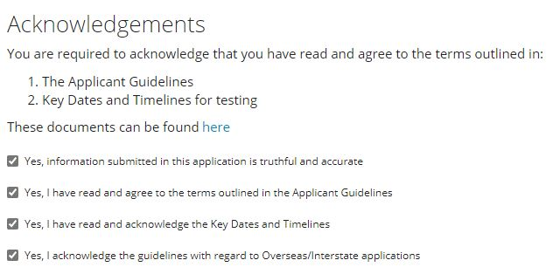
Acknowledgments
Confirm all to submit

Slide 28
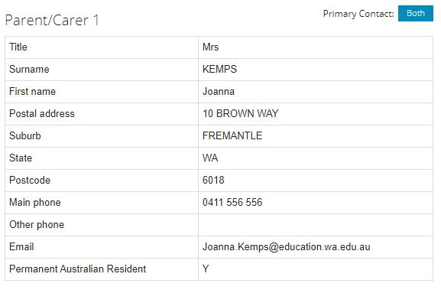
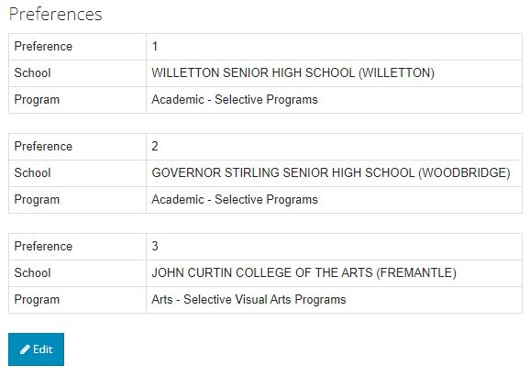
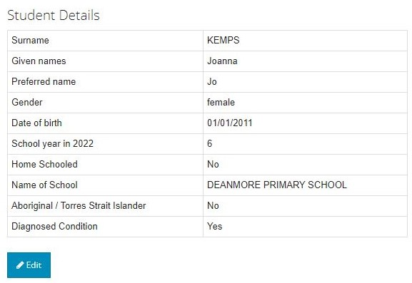
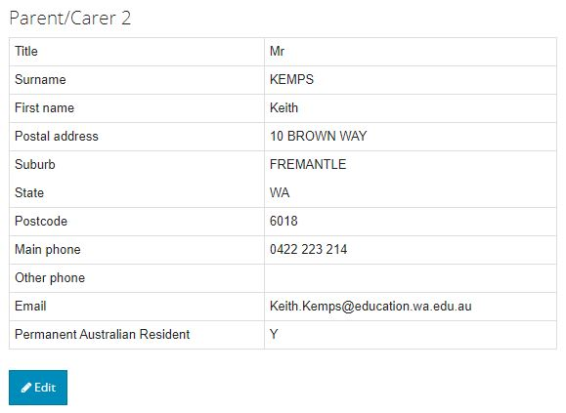
Check that your information is correct and SUBMIT

Slide 29
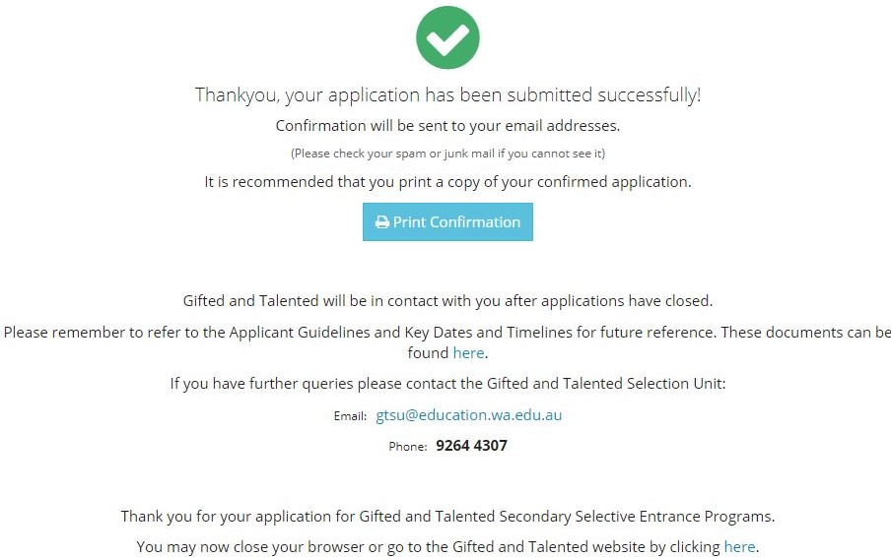
Application submitted successfully
Any changes to the application from this point can only by made by contacting the Gifted and Talented Selection Unit on 9264 4307 or gtsu@education.wa.edu.au
An automated email will be sent to the email address/s included in your child’s application.
Please contact GTSU if you do not receive this.

Slide 30
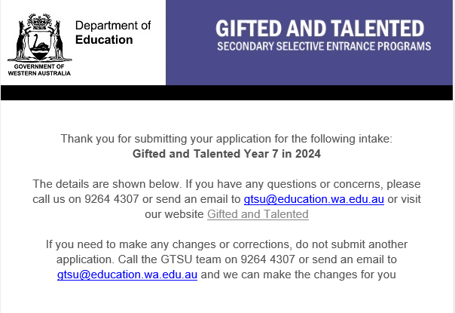
Confirmation email
Make sure you receive
Check details and contact GTSU with any changes
Keep a copy
Do not submit more than one application per child

Slide 31
Testing for academic programs
Testing Academic Selective Entrance Test
(ASET)
Placements Based solely on the results of the ASET.
Scores are ranked from the top down to fill a set number of vacancies for each program.

Slide 32
Testing for languages programs
Testing 1. ASET
2. Languages interview*
*Languages applicants who meet the qualifying ASET score will be invited to a Languages interview
Placement ASET (80%) and interview (20%)*
*Converted to a score out of 100. The combined score is ranked from the top down to fill a set number of vacancies for languages programs.

Slide 33
Testing for arts programs
MEDIA ARTS
DANCE
DRAMA
MUSIC THEATRE
TESTING
1. Workshop/Audition and possible call-back (65%) (all)
2. ASET (20%) (all)
3. Interview (15%) (selected students only)
PLACEMENT
Arts Total Score (out of 100) ranked from the top down.
TESTING
1. Workshop (60%) (all)
2. ASET (20%) (all)
3. Interview (20%) (selected students only)
PLACEMENT
Arts Total Score (out of 100) ranked from the top down.
VISUAL ARTS
TESTING
1. Aural testing and instrument viewing (all)
2. ASET (all)
Submission of a recorded audition on USB (all)
Final audition and interview (selected students only)
PLACEMENT
Applicants who progress to the final stage are ranked by instrument.
MUSIC
* Unsuccessful applicants may have the opportunity to reaudition for Music in Term 3.

Slide 34
Prior to the ASET
Sample Year 6 ASET and ASET Tips Sheet available on website end November
You can access the ASET – A Guide for Students video
Testing details email and Candidate Information Bulletin Feb/Mar 2023
Small, recent photo of applicant on Student Identification and Health Form
Reschedules due to illness or misadventure prior to test
So, what’s in the test . . .? ? ? ?

Slide 35
ASET
The ASET has four equally weighted components:
Reading Comprehension
Communicating Ideas in Writing
Quantitative Reasoning
Abstract Reasoning

Slide 36

Reading Comprehension
Assesses students’ ability to understand and interpret a range of texts, which may include fiction, non-fiction, poetry and drama, together with diagrams, tables, charts or maps.
No special knowledge in the subject area is required.
All the information you need to answer the questions is printed on the test paper.
FORMAT
35 multiple choice questions
35 minutes
No dictionary or thesaurus permitted

Slide 37
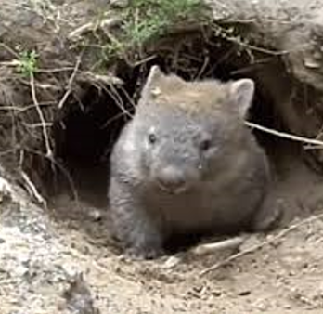
Reading Comprehension
EXAMPLE
The peaceful and submissive wombat
Abhors the very thought of combat.
Shaped like a shaggy little pig,
His joy is but to dig and dig.
A ten foot tunnel is to him
The product of a moment’s whim.
But when this impulse, urge or spasm
Is fanned into enthusiasm,
He’ll burrow on for miles and miles
And miles of subterranean aisles.

Slide 38
Reading Comprehension
EXAMPLE 1
Which of the following habits of the wombat is most strongly emphasised by the verse?
A It digs tunnels in which to hide
B It burrows with astonishing energy
C It moves quickly but without purpose
D It retreats underground the moment someone approaches
Answer: B

Slide 39

Reading Comprehension
EXAMPLE 2

Slide 40
Reading Comprehension
EXAMPLE
The text says that the moons and planets in the solar system move:
A at random
B frequently
C continuously
D anticlockwise
Answer: C

Slide 41

Communicating Ideas in Writing
Students are presented with a prompt and instructed to present a well organised, creative, interesting and original piece of writing
There is no restriction on genre or style
Marked differently from NAPLAN writing
25 minutes
EXAMPLES
or
What would have happened if….
The prompt can be an image, a piece of text, or both

Slide 42
Quantitative Reasoning
Assesses reasoning ability in mathematics and science (not based on school curriculum)
Candidates will be required to:
    extract and interpret information
    identify relationships, connections, similarities and differences
    solve problems
FORMAT
35 multiple choice questions
35 minutes
No calculators or rulers permitted

Slide 43
Quantitative Reasoning
EXAMPLE 1
Ben has two red socks and two blue socks in a drawer. They feel the same to touch. Suppose the first sock Ben takes out of the drawer is blue.
What is the chance of him taking out another blue sock?
A one in two
B one in three
C one in four
D one in six
Answer: B

Slide 44
Quantitative Reasoning
EXAMPLE 2
A water ski rope is designed to stretch 3% under full load.
To what length would a 20 metre water ski rope be stretched when under full load?
A 20.3 metres
B 20.6 metres
C 23 metres
D 26 metres
Answer: B

Slide 45

Abstract Reasoning
Assesses students’ ability to:
  recognise relationships and think logically
  hypothesise and complete sequences.
FORMAT
35 multiple choice questions (40 for older years)
20 minutes

Slide 46
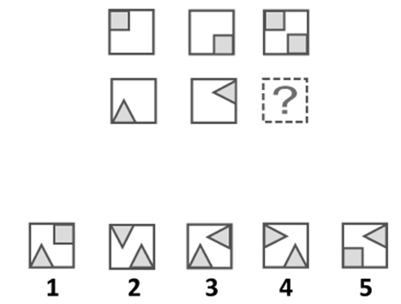
Abstract Reasoning
EXAMPLE 1
Answer: 3

Slide 47
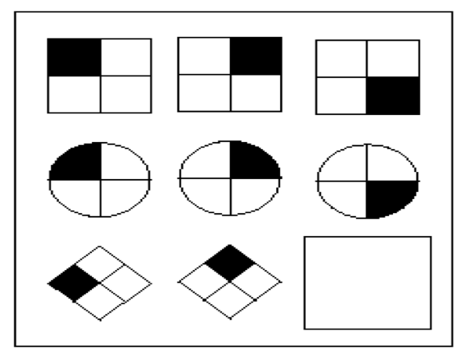
Abstract Reasoning
EXAMPLE 2
A
B
C
D
Answer: D

Slide 48
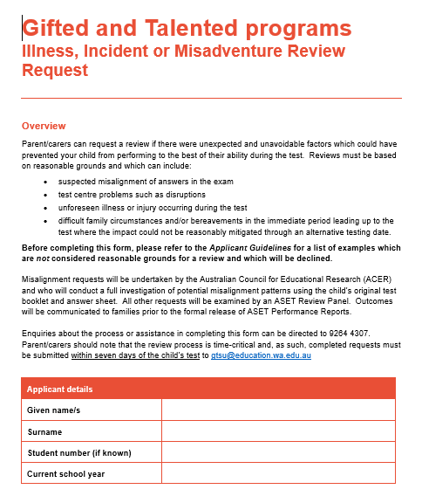
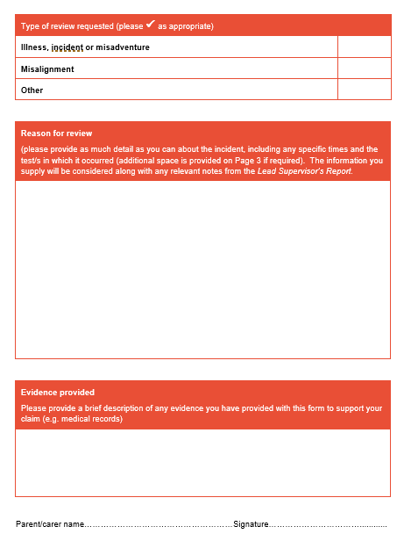
Illness, incident or misadventure reviews
Reviews can be requested for incidents occurring during the test which may have had a negative impact
Reviews can be on the basis of:
  Suspected misalignment of multiple choice answers
  Test centre problems or disruptions
  Unforeseen illness or injury occurring during or between tests
  Difficult family circumstances in the lead-up to the test unable to be reasonably mitigated by a reschedule
Reviews will not be accepted for:
  Known conditions for a which a reschedule and/or Adjusted Testing Conditions should have been sought
  Voluntary and avoidable activities
  Lack of familiarity/preparation, age or background
Must be submitted by email within seven days of the child’s testing date
Form available on website or by contacting GTSU
Score adjustments will occur prior to the release of ASET Performance Reports

Slide 49
ASET Performance Report
 | Minimum score achieved by any applicant | Maximum score achieved by any applicant | YOUR CHILD’S SCORE
Reading Comprehension | 24.58 | 82.55 | 69.87
Communicating Ideas in Writing | 0.51 | 101.58 | 51.04
Quantitative Reasoning | 23.65 | 88.49 | 69.67
Abstract Reasoning | 21.10 | 91.53 | 64.27
Total Standard Score (TSS) |  |  | 254.85
Standard score on each of the four components of the ASET (blue column)
Total Standard Score (TSS) (green box)
Benchmark score required for consideration for academic and languages programs is 210.00.
No minimum TSS required for arts programs.
Your child’s report does not indicate placement.
Previous minimum entrance scores available on website (guide only).
Sent via email.

Slide 50
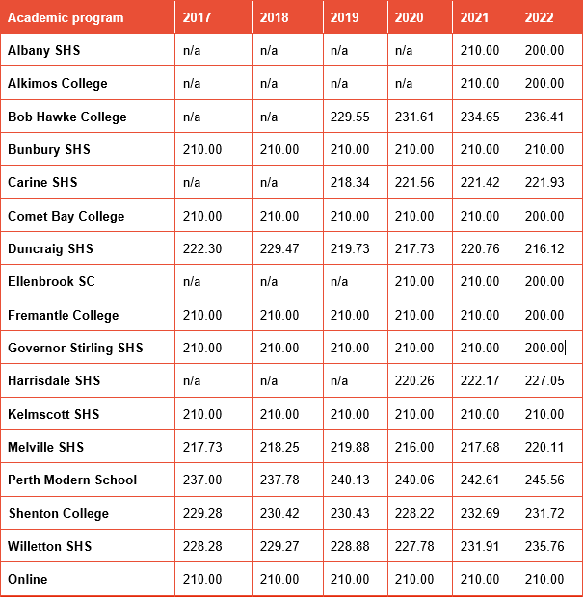
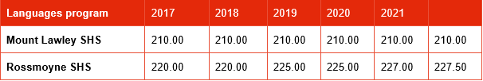
Previous minimum entrance scores
Previous scores do not represent 2024 scores. Use as an approximate guide to likelihood only.
Minimum TSS for previous years represents the very lowest score that resulted in an offer of placement by the end of the placement process.
The minimum entrance scores for Years 9, 10 and 11 can be vastly different due to limited vacancies.

Slide 51
Preference changes
Parents can change their child’s preferences after receiving their Performance Report with the exception of:
    New arts preferences – all arts testing will have concluded by this time.
    New languages preferences:
      must be requested by Monday, 22 May to be included in the first round of interviews (before performance reports are released)
      any languages preferences requested after 22 May will be for a potential second round of interviews only.
Preference changes can only be made by phone or emailing GTSU.
Preference change requests must be received by GTSU by the deadline on the Performance Report email (usually 7 working days).

Slide 52
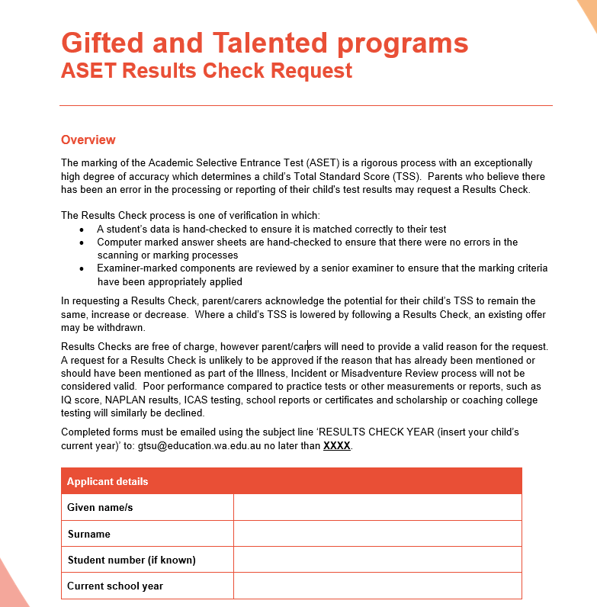
Results checks
You can request a Results Check after you receive your child’s report
One or more components of the ASET
A process of verification to ensure:
  Data was matched correctly
  No scanning errors in the multiple choice tests
  Hand-marked components reviewed by a senior examiner
No checks for illness, incident or misadventure (includes misalignment)
You must be prepared for and accept any possible outcome
Form must be submitted by email by the deadline stated (usually 7 working days)
The Results Check Request form will be available on the website from the release of reports

Slide 53
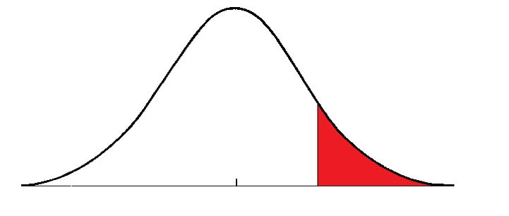
Minimum 210 TSS for academic programs
Students who score a minimum TSS of 210 can be considered for academic program placement.
Student TSS is the combined standard score from all four components of the ASET.
Top one third of all applicants who sat the ASET
Below 210
210 and
above

Slide 54
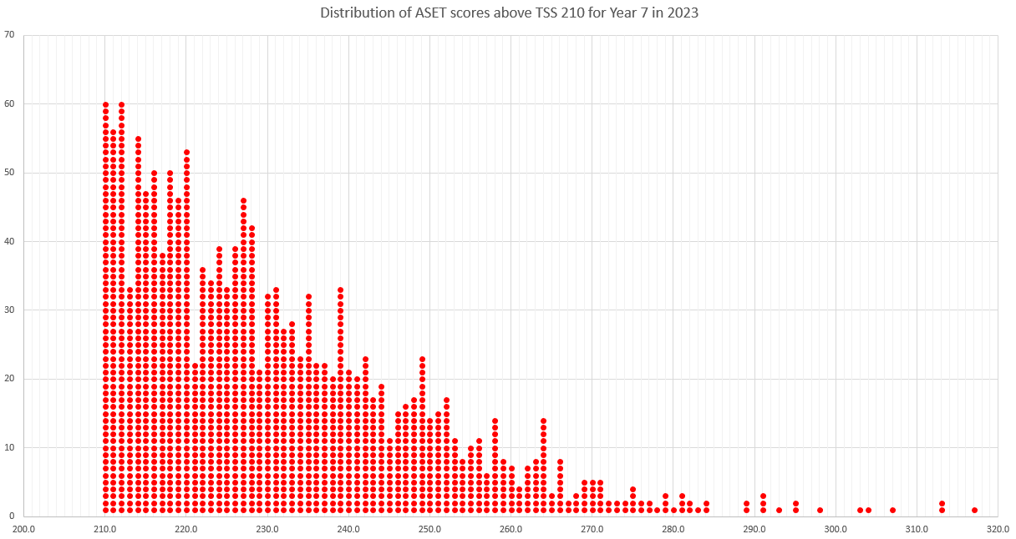
Distribution of scores above 210 (1541 children)
53 children scored between 220.00 and 220.99

Slide 55
Offers
There are two formal rounds of offers: round one followed later by round two.
Academic, arts and languages places are offered at the same time in each round.
Applicants will be considered for each of their preferences – independent of each other.
Qualifying applicants will receive a maximum of one offer per round.
Any offer received represents the highest preference they have qualified for.
An applicant who receives a second or third preference offer in round one has the option to HOLD that offer going into round two.
All declined offers from round one go into the pool for round two.
Responses required within 7 working days.

Slide 56
Round 1 offer example
A Year 6 child who:
  achieved the minimum TSS of 210. They are eligible to be considered for academic placement. ✓
  progressed to the interview stage for an arts program. Eligible to be considered for arts placement. ✓
Preferences: 1. Sunnyville Senior High School - academic (64 places)
2. Golden Senior High School - academic (32 places)
3. Spring College of the Arts - arts (32 places)
Sunnyville Senior High School
Golden Senior High School
Spring College of the Arts
Preference 2 positioned 27th
OUTCOME
Offer for
Golden SHS
32 places
32 places
Preference 1
positioned 85th
64 places
Preference 3 positioned 15th

Slide 57
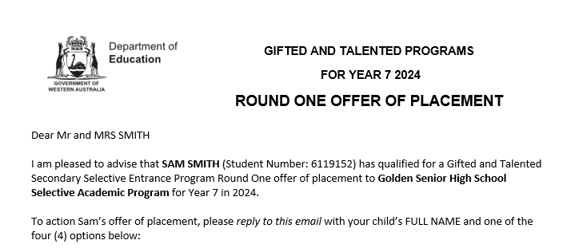

Round 1 Offer of Placement
HOLD is an option for second or third preferences only

Slide 58
Round 2 offer example
ACTIVE PREFERENCES
Sunnyville Senior High School (10 places left after Round 1)
Golden SHS (current offer placed on HOLD pending outcome of Round 2)
Sunnyville Senior High School
OUTCOME
Repeat Offer for
Golden SHS
Preference 1
positioned 12th
10 places available

Slide 59
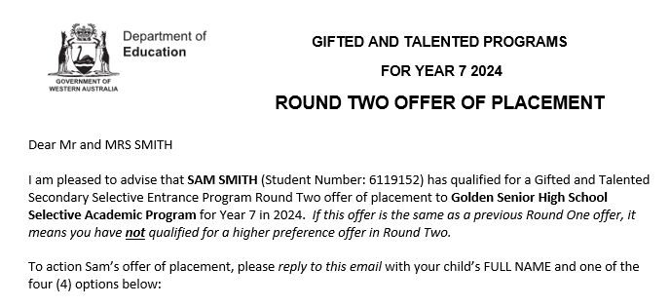

Round 2 Offer of Placement
Round 2 offers cannot be put on HOLD

Slide 60
Reserve lists and Reserve offers
Children who do not receive an offer of placement will be automatically placed on the Reserve List if they meet the eligibility criteria for their preferences
Academic program reserve list eligibility will vary
All Reserve List offers will be made by email
Parents will have up to 48 hours to accept or decline
Reserve List will close on 1 December 2023.

Slide 61
Key dates to remember
Applications close 11.59pm Sunday, 12 February 2023
Deadline for Adjusted Testing Conditions and ASET exemption requests Wednesday, 22 February 2023
Metro, Bunbury and Albany standard testing of Year 6 students will occur on
Saturday, 11 March.
Metro, Bunbury and Albany standard testing of Year 8, 9 and 10 students will occur on
Sunday, 12 March.
Arts testing occurs throughout Term 1
Arts and Languages interviews will occur in Term 2
ASET Performance reports emailed late May
Offers will start in early June
Unsuccessful notifications will be sent by email in August

Slide 62
Where to go to apply:
www.education.wa.edu.au/giftedandtalented
For all enquiries or to request a change to your child’s application:
Email: gtsu@education.wa.edu.au
or
Phone: 9264 4307
APPLICATIONS NOW OPEN ONLINE

