Slide 1
Gifted and Talented Secondary Selective Entrance programs
Parent presentation for the 2026 intake
Presented by the Gifted and Talented Selection Unit

Slide 2
We acknowledge and respect the traditional custodians of the lands and waters on which our students live and are educated throughout Western Australia.
We acknowledge and understand that Elders, parents, families and communities are the first educators of their children and we recognise and value the cultures and strengths that Aboriginal children bring to the classroom. Aboriginal people have a long tradition of teaching and learning through sharing their connections with country, community, language and culture, and through their oral histories, stories and lived experiences that are passed from generation to generation. We recognise and value the learning that Aboriginal children bring with them from their homes and communities into the classroom.

Slide 3
Programs
How to apply
Testing processes
Results
Offers of placement
Key dates

Slide 4
Options in public high schools
Programs
How to apply
Testing processes
Results
Offers of placement
Key dates
School-based programs
    any subject
    school selected and funded
    local catchment students only
UNLIMITED
Unlimited
2. Approved Specialist programs
    school selected and funded
    Department endorsed
    Local catchment and potential for outside intake
OVER 100 IN WA
3. Gifted and Talented Secondary Selective Entrance
    Department selected and fully Government funded
    applicants from WA, interstate and overseas
    no advantage for local catchment
ONLY
24
IN WA
Academic
online
program
+

Slide 5
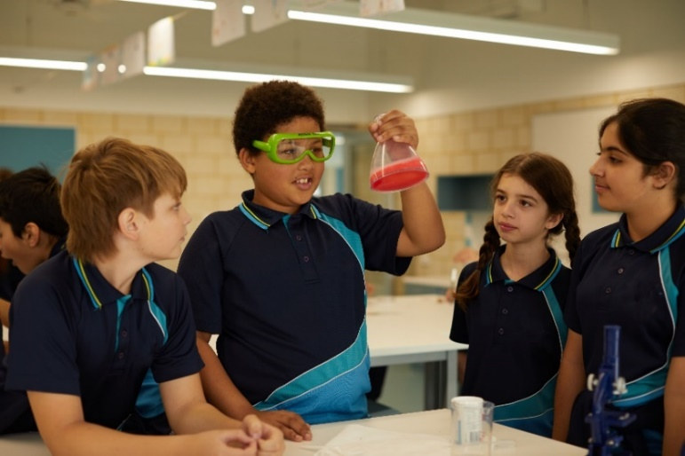



Types of Gifted and Talented programs
Programs
How to apply
Testing processes
Results
Offers of placement
Key dates
  Academic
  Arts
  Languages

Slide 6
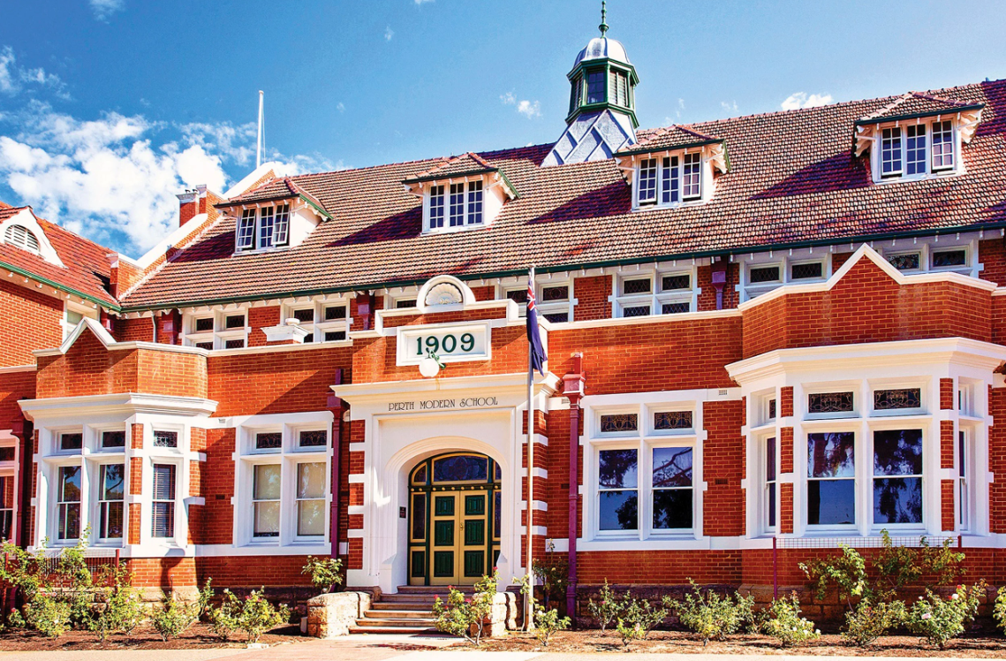
Academic programs – fully selective school
Programs
How to apply
Testing processes
Results
Offers of placement
Key dates
Perth Modern School
  No local catchment intake
  225 places available for the start of Year 7
  Can apply for entry to Years 9, 10 and 11
  Year 9 intake based on vacated places
  Up to 25 additional places made available for Year 10 and 11 intakes

Slide 7

Academic programs – partially selective schools
Programs
How to apply
Testing processes
Results
Offers of placement
Key dates
Metro host schools
Alkimos College
Bob Hawke College
Carine SHS
Comet Bay College
Duncraig SHS
Ellenbrook SC
Fremantle College
Regional host schools
Albany SHS
Bunbury SHS
Governor Stirling SHS
Harrisdale SHS
Kelmscott SHS
Melville SHS
Shenton College
Willetton SHS
  Local catchment for non-selected students
  Students grouped for Mathematics, Science, English and Humanities and Social Sciences (HASS)
  Between 32 and 64 places at the start of Year 7 for selected students
  Apply for entry in Years 9, 10 and 11 for vacated places

Slide 8
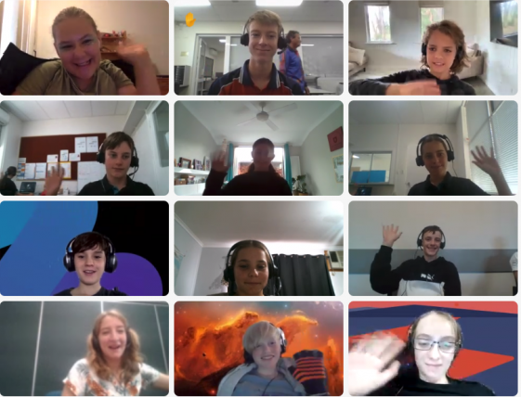
Academic programs – regional online
Programs
How to apply
Testing processes
Results
Offers of placement
Key dates
Selective Academic Program online
  Operates out of any regional public high school (excluding Albany and Bunbury region)
  Uses computer links and innovative technology
  Unlimited vacancies for entry in years 7, 9 and 10
  Maths/Science, English/HASS or both
  For more information: gtonline.wa.edu.au

Slide 9
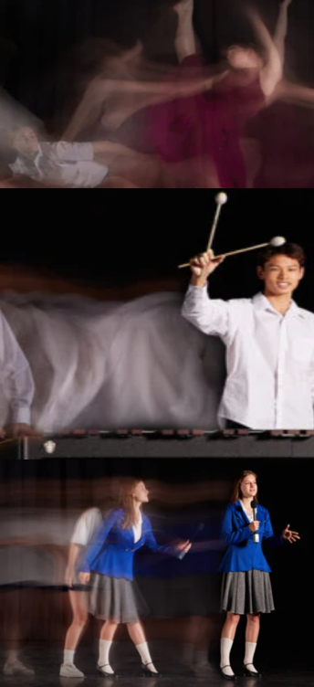
Arts programs – arts college
Programs
How to apply
Testing processes
Results
Offers of placement
Key dates
John Curtin College of the Arts
  Up to 240 places at the start of Year 7 across six arts programs:
    Dance (contemporary and classical ballet) – 50 places
    Drama – 60
    Music Theatre – 25 places
    Media Arts – 40
    Visual Arts – 22 places
    Music – 40 places
  Small local catchment intake and Specialist Soccer program
  Students grouped in their arts program classes
  Apply for entry in Years 9, 10 and 11 for vacated places
  No Music Theatre entry in Years 9-11 in 2026
  No Media Arts entry in Year 10, 2026

Slide 10
Arts programs – partially selective schools
Programs
How to apply
Testing processes
Results
Offers of placement
Key dates
Contemporary Dance
Hampton SHS – 32 places
Music
Churchlands SHS – 50 places
Visual Arts
Applecross SHS – 32 places
Balcatta SHS – 32 places
Kalamunda SHS - 32 places
  Students grouped in their arts program classes
  Local catchment for non-selected students
  Testing for vacated places in Years 9, 10 and 11
  No Applecross Visual Arts Year 11 in 2026

Slide 11
Languages programs – partially selective schools
Programs
How to apply
Testing processes
Results
Offers of placement
Key dates
Rossmoyne SHS
Chinese (Mandarin)
French
German
Japanese
40 combined places
Mount Lawley SHS
Chinese (Mandarin)
Italian
32 combined places
  Local catchment for non-selected students
  Students grouped in their languages program classes
  Apply for entry in Year 9 for vacated places – must have studied the language at school in Years 7 and 8
      No Chinese (Mandarin) at Rossmoyne Year 9 in 2026
  The School Curriculum and Standards Authority (SCSA) will determine eligibility for Year 11 and 12 subject selection

Slide 12

City Beach Residential College
Programs
How to apply
Testing processes
Results
Offers of placement
Key dates
Boarding available
  For regional WA students only
  Live in Perth with other country students, sharing the experience of being in a Perth-metro Gifted and Talented program
  Boarding allowance may be available
  Visit education.wa.edu.au/web/citybeachresidentialcollege
Current residents from:
  Perth Modern School
  John Curtin College of the Arts
  Bob Hawke College
  Shenton College
  Churchlands Senior High School
  Fremantle College

Slide 13
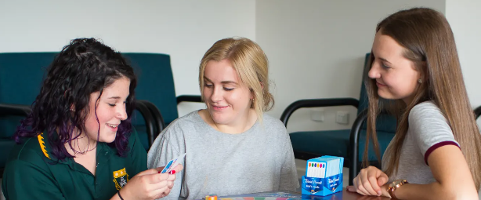
Albany Residential College
Programs
How to apply
Testing processes
Results
Offers of placement
Key dates
Boarding available
  For regional WA students attending Albany SHS
  Live at the Residential College with other country students, sharing the experience of being in a Gifted and Talented program
  The college currently has 80 students boarding from Years 7 to 12
  Located adjacent to Albany Senior High School
  Boarding allowance may be available
  Visit education.wa.edu.au/web/albanyresidentialcollege for more information

Slide 14




Gifted and Talented website education.wa.edu.au/gifted-and-talented
Programs
How to apply
Testing processes
Results
Offers of placement
Key dates
Notes:
Update graphic

Slide 15
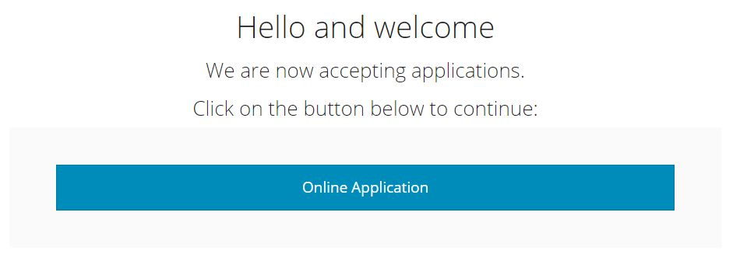
Lodging an application
Programs
How to apply
Testing processes
Results
Offers of placement
Key dates
Notes:
Update graphic

Slide 16
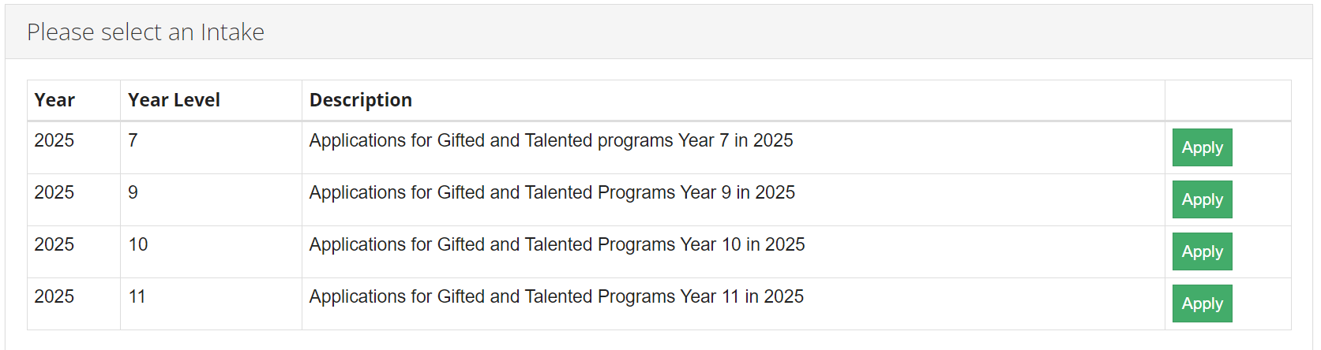
Lodging an application
Programs
How to apply
Testing processes
Results
Offers of placement
Key dates

Slide 17
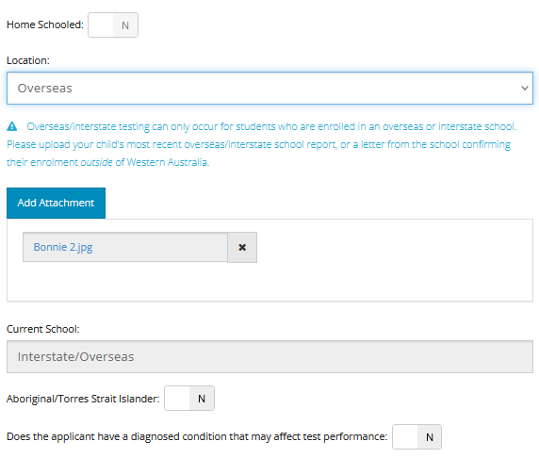
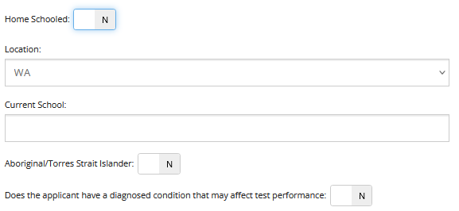

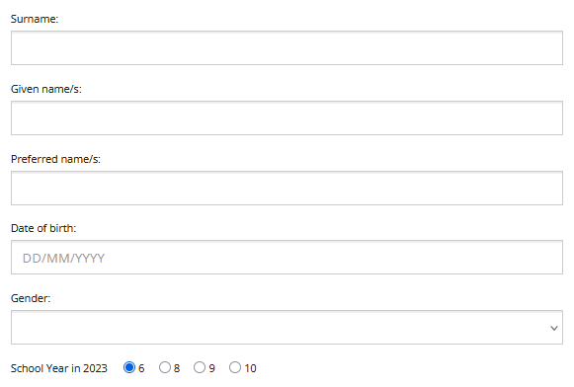
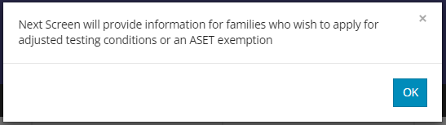
Your child’s details
Programs
How to apply
Testing processes
Results
Offers of placement
Key dates
Children will be sent to the same testing session as other students at the same school
If home schooled, select your local catchment school
Only available if your child is enrolled outside of WA
SEPARATE APPLICATION PROCESS
Notes:
Date of birth and year
Kids in WA – school = testing allocation
Home school – closest school
OSIS – only if enrolled out of WA, evidence required
Diagnosed condition – information on how to apply if you say yes
SEPARATE PROCESS – ticking yes is not an application

Slide 18
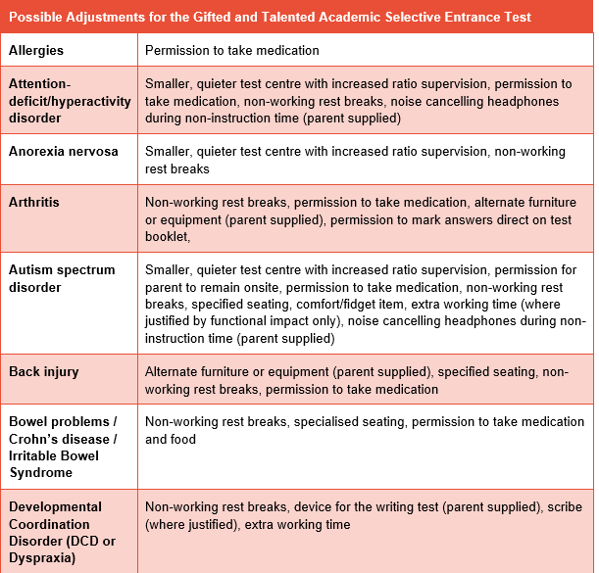
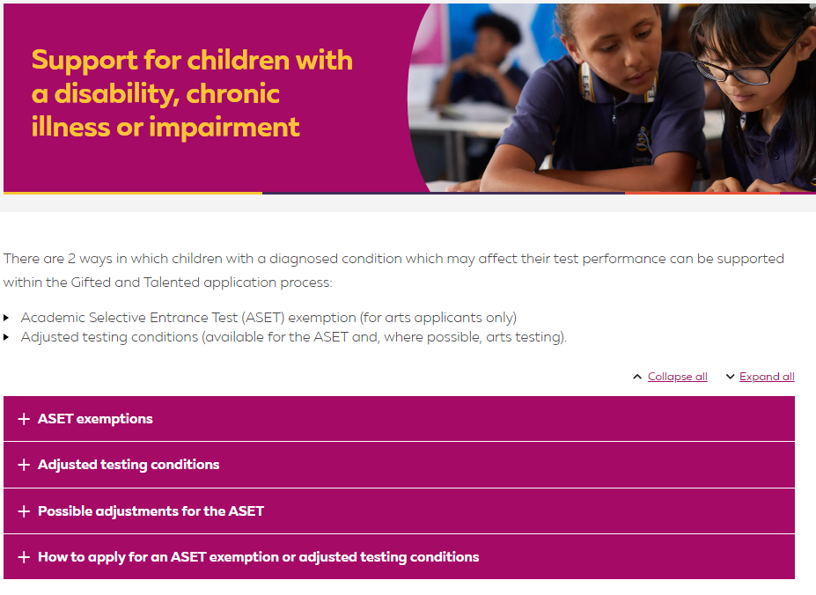

Adjusted Testing Conditions and ASET Exemptions
Programs
How to apply
Testing processes
Results
Offers of placement
Key dates
Notes:
Update graphic

Slide 19
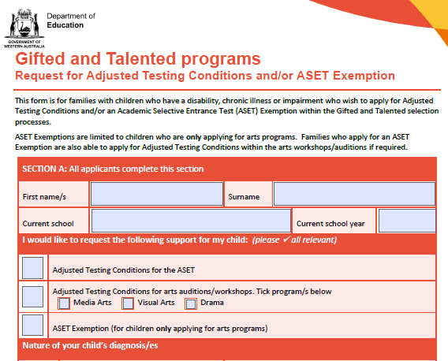
Adjusted Testing Conditions and ASET Exemptions
Programs
How to apply
Testing processes
Results
Offers of placement
Key dates
There is a section you will need to ask your child’s school to complete, make sure you leave the time for this
Completed forms and supporting evidence due no later than Monday, 17 February 2025

Slide 20
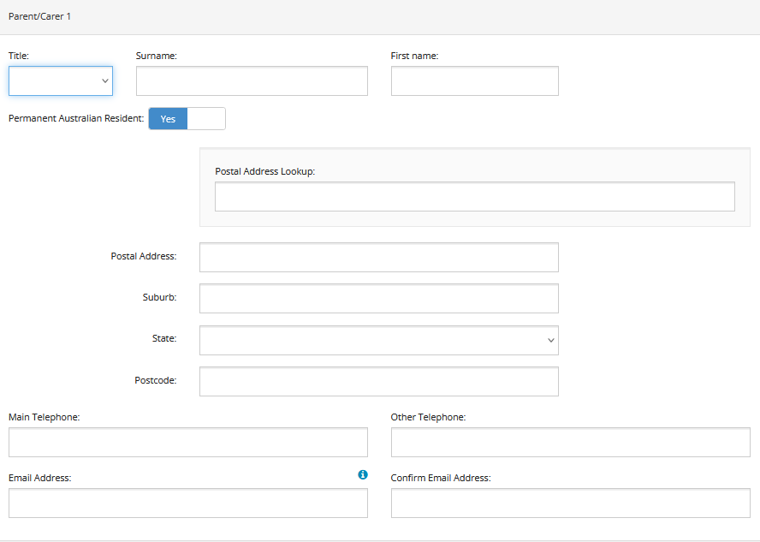
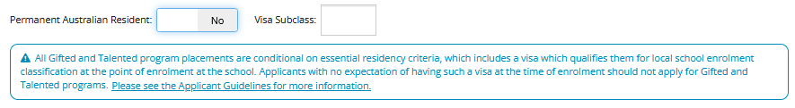

Parent/carer contact information
Programs
How to apply
Testing processes
Results
Offers of placement
Key dates
Notes:
Option for 2 parent/carers. Importance of valid email address/addresses – we default send to both. OSIS.

Slide 21
Selecting preferences
Programs
How to apply
Testing processes
Results
Offers of placement
Key dates
The preferences video can be viewed here.

Slide 22
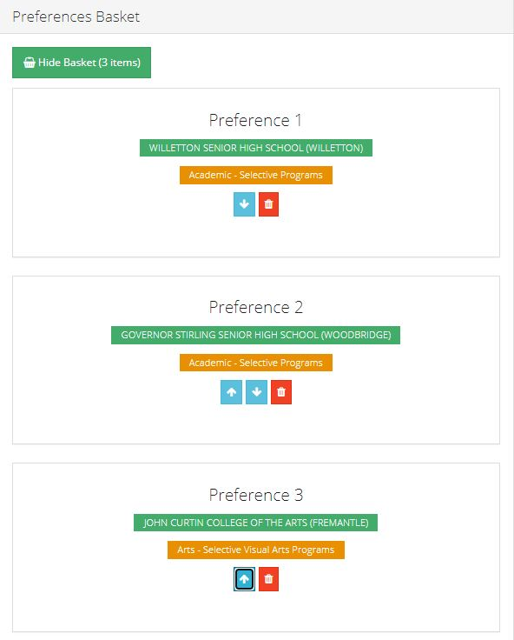
Selecting preferences summary
Programs
How to apply
Testing processes
Results
Offers of placement
Key dates
Maximum of three preferences
Your preferences determine the testing your child will be invited to attend
No test = no consideration for placement
Once you have lodged your application, any changes need to be requested in writing to gtsu@education.wa.edu.au or by phone to 9264 4307
Please do not lodge multiple applications for the same child as they will be deleted

Slide 23
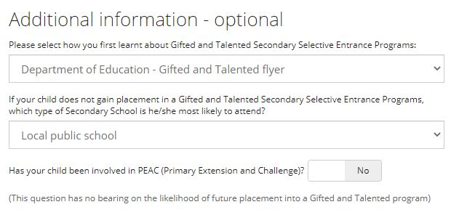
Additional information
Programs
How to apply
Testing processes
Results
Offers of placement
Key dates
Statistical questions only

Slide 24
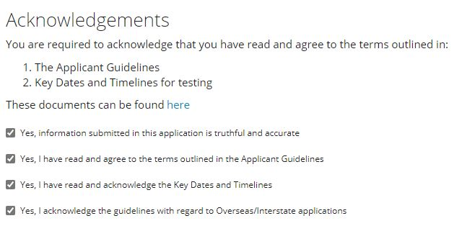
Acknowledgements
Programs
How to apply
Testing processes
Results
Offers of placement
Key dates
Confirm all to submit

Slide 25
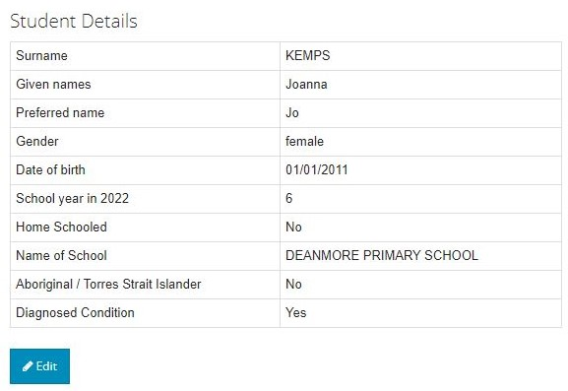
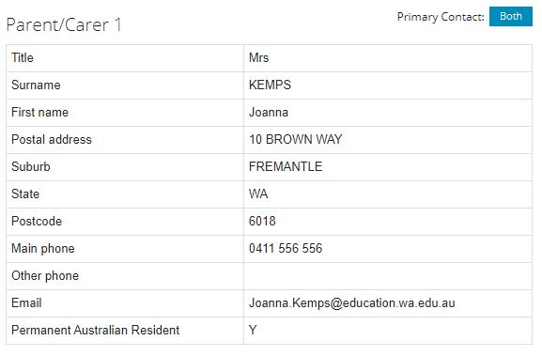
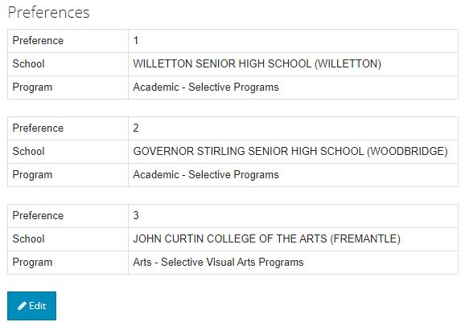
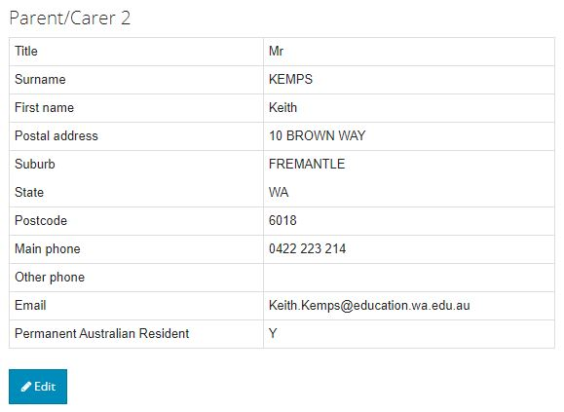
Pre-submit check of your application
Programs
How to apply
Testing processes
Results
Offers of placement
Key dates

Slide 26

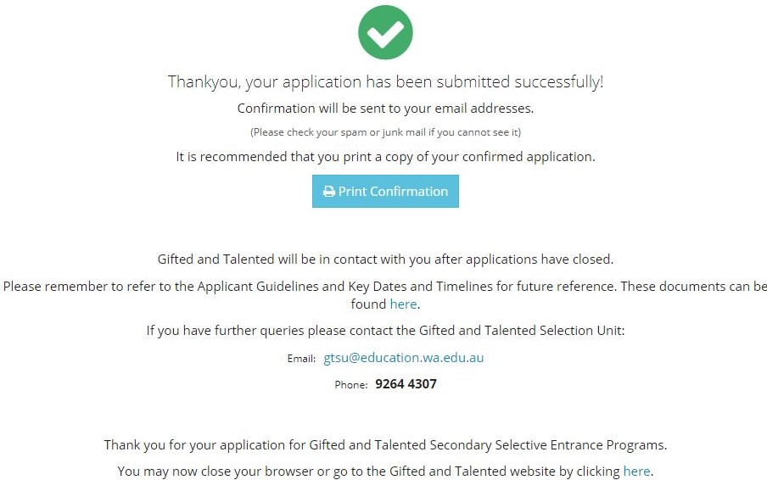
Application submitted successfully
Programs
How to apply
Testing processes
Results
Offers of placement
Key dates
An automated email of receipt will be sent to the email address/s included in your child’s application.
It will have your child’s preferences, so keep it as a reminder.
Please contact GTSU if you do not receive this.

Slide 27
Testing for academic programs
Programs
How to apply
Testing processes
Results
Offers of placement
Key dates
Testing Academic Selective Entrance Test
(ASET)
Placements Based solely on the results of the ASET.
Scores are ranked from the top down to fill a set number of vacancies for each program.

Slide 28
Testing for languages programs
Programs
How to apply
Testing processes
Results
Offers of placement
Key dates
Testing 1. ASET
2. Languages interview*
*Languages applicants who meet a minimum ASET score will be invited to a Languages interview
Placement ASET (80%) and interview (20%)*
*Converted to a score out of 100. The combined score is ranked from the top down to fill a set number of vacancies for languages programs.

Slide 29
Testing for arts programs
Programs
How to apply
Testing processes
Results
Offers of placement
Key dates
MEDIA ARTS
DANCE
DRAMA
MUSIC THEATRE
TESTING
1. Workshop/Audition and possible call-back (65%) (all)
2. ASET (20%) (all)
3. Interview (15%) (selected students only)
PLACEMENT
Arts Total Score (out of 100) ranked from the top down.
TESTING
1. Workshop (60%) (all)
2. ASET (20%) (all)
3. Interview (20%) (selected students only)
PLACEMENT
Arts Total Score (out of 100) ranked from the top down.
VISUAL ARTS
TESTING
1. Instrument viewing (all)
2. ASET (all)
Submission of a recorded audition on USB (all)
Final audition, aural testing and interview (selected students only)
PLACEMENT
Applicants who progress to the final stage are ranked by instrument.
MUSIC
* Unsuccessful applicants may have the opportunity to reaudition for Music in Term 3.

Slide 30
Prior to the ASET and Arts testing
Programs
How to apply
Testing processes
Results
Offers of placement
Key dates
Resources available now:
  Applicant Guidelines and Key Dates
  Adjusted Testing Conditions and ASET Exemption Request Form
  Sample Year 6 ASET and answer booklet
  ASET Overview and Tips
ASET and Arts Testing Details emails (where, what time, etc) from end of Feb
Student Identification Form (photo required, one per test)
Reschedules available for children who are unwell leading up to the test or on the day

Slide 31
ASET
Programs
How to apply
Testing processes
Results
Offers of placement
Key dates
The ASET has four equally weighted sub-tests:
  Reading Comprehension
  Communicating Ideas in Writing
  Quantitative Reasoning
  Abstract Reasoning

Slide 32

Reading Comprehension
Programs
How to apply
Testing processes
Results
Offers of placement
Key dates
Assesses students’ ability to understand and interpret a range of texts, which may include fiction, non-fiction, poetry and drama, together with diagrams, tables, charts or maps.
No special knowledge in the subject area is required.
All the information you need to answer the questions is printed on the test paper.
FORMAT
35 multiple choice questions
35 minutes
No dictionary or thesaurus permitted

Slide 33

Programs
How to apply
Testing processes
Results
Offers of placement
Key dates
Reading Comprehension
EXAMPLE 1
Out of the harbour
With that three-cornered fin,
Shearing without a bubble the water
Lithely,
Leisurely
He swam –
That strange fish,
Tubular, tapered, smoke-blue,
Part vulture, part wolf,
Part neither – for his blood was cold

Slide 34
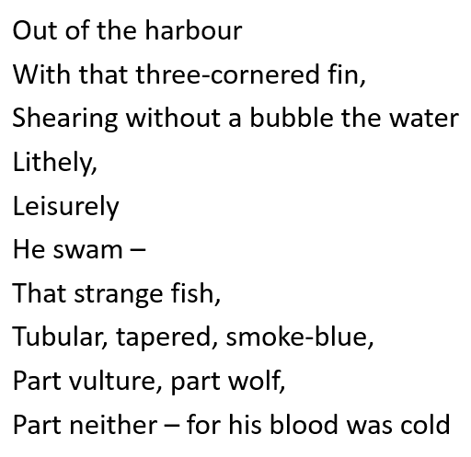
Reading Comprehension
Programs
How to apply
Testing processes
Results
Offers of placement
Key dates
EXAMPLE 1
Which traits of the shark are most strongly emphasised by the verse?
A It has cold blood
B It is dangerous and predatory
C It doesn’t splash or hurry when it swims
D It is strange to look at
Answer: B

Slide 35

Reading Comprehension
Programs
How to apply
Testing processes
Results
Offers of placement
Key dates
EXAMPLE 2

Slide 36
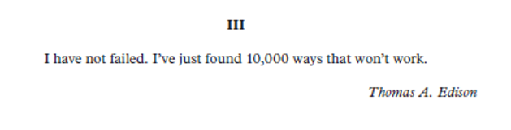
Reading Comprehension
Programs
How to apply
Testing processes
Results
Offers of placement
Key dates
EXAMPLE 2
Quotation III is most likely intended to be
A self-pitying.
B an angry rebuke.
C mildly humorous.
D a triumphant declaration.
Answer: C

Slide 37

Communicating Ideas in Writing
Programs
How to apply
Testing processes
Results
Offers of placement
Key dates
Students are presented with a prompt and instructed to present a well organised, creative, interesting and original piece of writing
There is no restriction on genre or style
Marked differently from NAPLAN writing
25 minutes
EXAMPLES
Time stood still …
or
The prompt can be an image, a piece of text, or both

Slide 38

Quantitative Reasoning
Programs
How to apply
Testing processes
Results
Offers of placement
Key dates
Assesses reasoning ability in mathematics and science (not based on school curriculum)
Candidates will be required to:
    extract and interpret information
    identify relationships, connections, similarities and differences
    solve problems
FORMAT
35 multiple choice questions
35 minutes
No calculators or rulers permitted

Slide 39
Quantitative Reasoning
Programs
How to apply
Testing processes
Results
Offers of placement
Key dates
EXAMPLE 1
Ben has two red socks and two blue socks in a drawer. They feel the same to touch. Suppose the first sock Ben takes out of the drawer is blue.
What is the chance of him taking out another blue sock?
A one in two
B one in three
C one in four
D one in six
Answer: B

Slide 40
Quantitative Reasoning
Programs
How to apply
Testing processes
Results
Offers of placement
Key dates
EXAMPLE 2
A water ski rope is designed to stretch 3% under full load.
To what length would a 20-metre water ski rope be stretched when under full load?
A 20.3 metres
B 20.6 metres
C 23 metres
D 26 metres
Answer: B

Slide 41
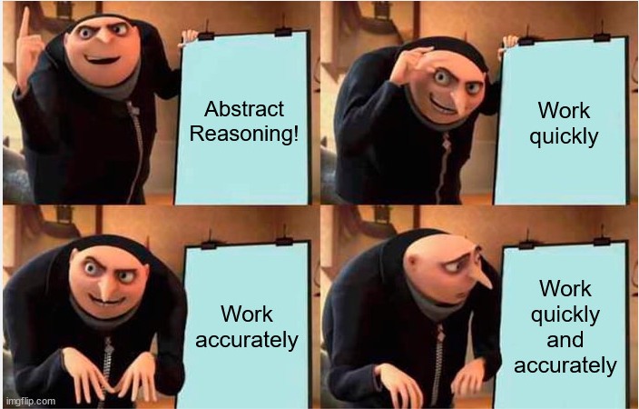
Abstract Reasoning
Programs
How to apply
Testing processes
Results
Offers of placement
Key dates
Assesses students’ ability to:
  recognise relationships and think logically
  hypothesise and complete sequences
  Work quickly and accurately
FORMAT
Multiple choice
  35 questions
  20 minutes

Slide 42
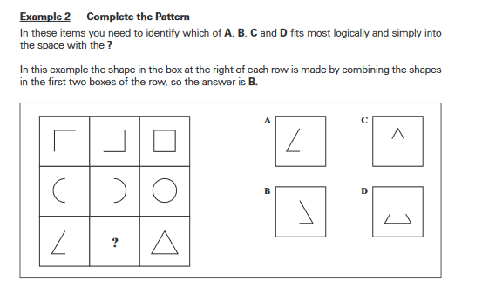
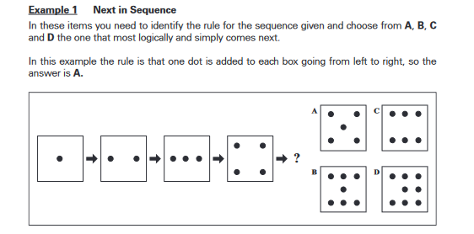
Abstract Reasoning
Programs
How to apply
Testing processes
Results
Offers of placement
Key dates
Two question types

Slide 43
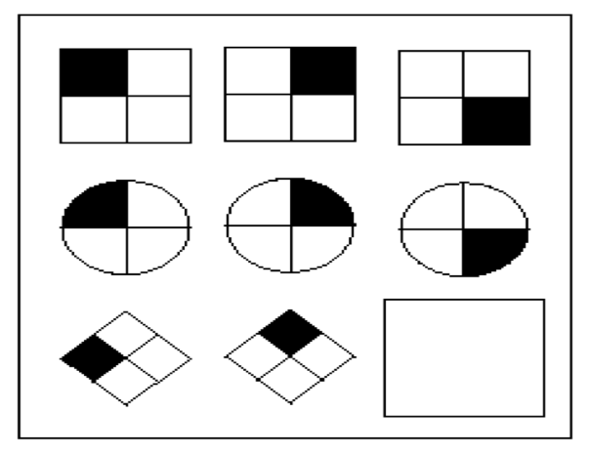
Abstract Reasoning
Programs
How to apply
Testing processes
Results
Offers of placement
Key dates
EXAMPLE 1
A
B
C
D
Answer: D

Slide 44
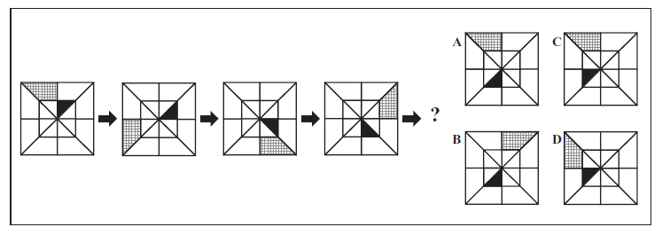
Abstract Reasoning
Programs
How to apply
Testing processes
Results
Offers of placement
Key dates
EXAMPLE 2
Answer: A

Slide 45

Illness, incident or misadventure review requests
Programs
How to apply
Testing processes
Results
Offers of placement
Key dates
Reviews can be requested for incidents occurring during the test which may have had a negative impact
Reviews can be on the basis of:
  Suspected misalignment of multiple-choice answers
  Test centre problems or disruptions
  Unforeseen illness or injury during or between tests
  Difficult family circumstances unable to be reasonably mitigated by a reschedule
Reviews will not be accepted for:
  Known conditions
  Voluntary and avoidable activities
  Lack of familiarity or finding the test difficult
Must be submitted by email within seven days of the child’s testing date. Form available on website or by contacting GTSU
Any score adjustments will occur prior to the release of ASET Performance Reports
Notes:
Update graphic

Slide 46
ASET Performance Report
Programs
How to apply
Testing processes
Results
Offers of placement
Key dates
 | Student Number xxxx | Minimum score in 2024 | Maximum score in 2024
Reading Comprehension | 66.67 | 18.94 | 79.12
Communicating Ideas in Writing | 57.17 | 11.14 | 86.46
Quantitative Reasoning | 56.3 | 23.81 | 82.69
Abstract Reasoning | 54.18 | 21.70 | 82.33
Total Standard Score | 234.32
Standard score on each of the four components of the ASET (blue column)
Total Standard Score (TSS) (green box)
Benchmark score required for consideration for academic and languages programs is 210.00 (rounded up from 209.50)
No minimum TSS required for arts programs.
Your child’s report does not indicate placement.
Previous minimum entrance scores available on website (guide only).
Notes:
Update graphic

Slide 47

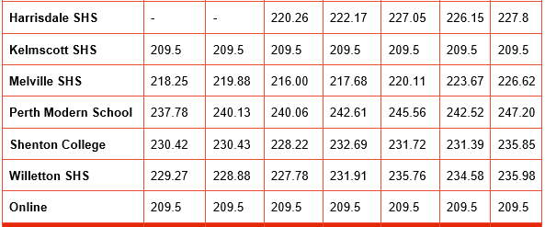
Previous minimum entrance scores
Programs
How to apply
Testing processes
Results
Offers of placement
Key dates
Previous scores do not represent 2025 scores. Use as an approximate guide to likelihood only.
Minimum TSS for previous years represents the very lowest score that resulted in an offer of placement by the end of the placement process.
The minimum entrance scores for Years 9, 10 and 11 can be vastly different due to limited vacancies.
Sample

Slide 48
Preference changes
Programs
How to apply
Testing processes
Results
Offers of placement
Key dates
Parents can change their child’s preferences after receiving their Performance Report with the exception of:
    New arts preferences – all arts testing will have concluded by this time.
    New languages preferences:
      must be requested by 22 May 2025 to be included in the first round of interviews (before performance reports are released)
      any languages preferences requested after 22 May will be for a potential second round of interviews only.
Preference change requests must be made by phone or email by a parent/carer listed on the child’s application.
Preference change requests must be received by GTSU by the deadline on the Performance Report email (usually 7 working days).

Slide 49
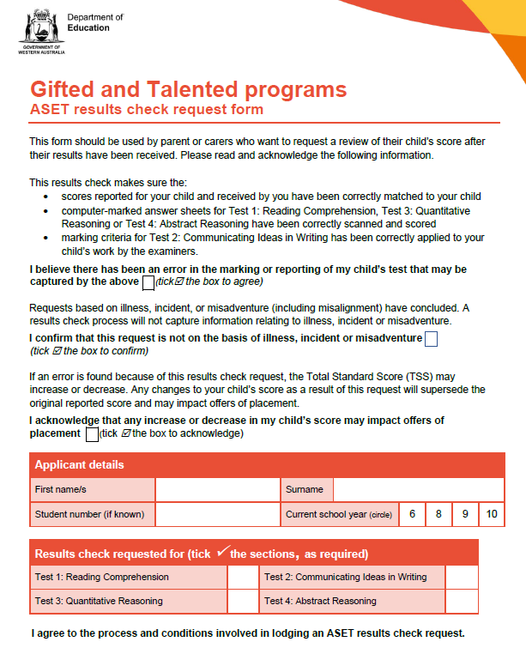
Results checks
Programs
How to apply
Testing processes
Results
Offers of placement
Key dates
You can request a Results Check after you receive your child’s report for one or more components.
A Results Check is a process of verification to ensure:
  Data was matched correctly
  No scanning errors in the multiple-choice tests
  Writing task appropriately scored
No checks for illness, incident or misadventure (includes misalignment)
If an error is found, you must accept the outcome – whatever that is
Form must be submitted by email by the deadline stated (usually 7 working days)
The Results Check Request form will be available on the website from the release of reports
Outcomes will be known just before the second round of offers
Notes:
Update graphic

Slide 50
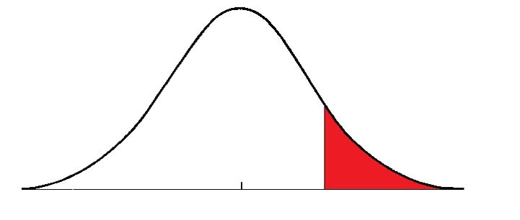
Minimum 210 TSS for academic programs
Programs
How to apply
Testing processes
Results
Offers of placement
Key dates
Top one third of all applicants who sat the ASET
Students who score a minimum TSS of 210 can be considered for academic program placement.
Student TSS is the combined standard score from all four components of the ASET.
Below 210
210 and
above

Slide 51
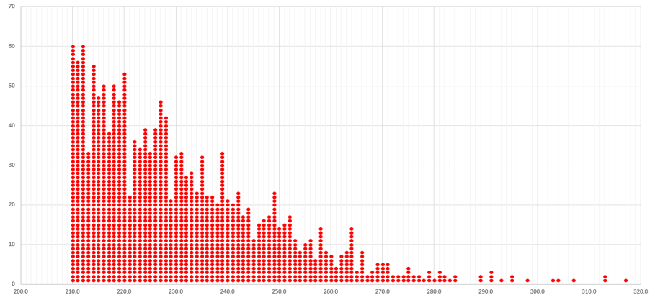
Distribution of scores above 210
Example Year 7 entry in 2023
Programs
How to apply
Testing processes
Results
Offers of placement
Key dates

Slide 52
Offers
Programs
How to apply
Testing processes
Results
Offers of placement
Key dates
There are two formal rounds of offers: round one followed later by round two.
Academic, arts and languages places are offered at the same time in each round.
Applicants will be considered for each of their preferences – independent of each other.
Qualifying applicants will receive a maximum of one offer per round.
Any offer received represents the highest preference they have qualified for.
An applicant who receives a second or third preference offer in round one has the option to HOLD that offer going into round two.
All declined offers from round one go into the pool for round two.
Responses required within 7 working days.

Slide 53
Offers scenario Round 1
Programs
How to apply
Testing processes
Results
Offers of placement
Key dates
A Year 6 child who:
  progressed to the interview stage for the dance program. Eligible to be considered for dance placement. ✓
  achieved the minimum TSS of 210. They are eligible to be considered for academic placement. ✓
Preferences: 1. Duncraig SHS – academic (32 places)
2. Alkimos College - academic (32 places)
3. Hampton SHS – dance (32 places)
Duncraig Senior High School
Alkimos College
Hampton Senior High School
Preference 3 positioned 15th
Preference 2 positioned 27th
OUTCOME
Offer for
Alkimos College
32 places
32 places
Preference 1
positioned 44th
32 places

Slide 54

Programs
How to apply
Testing processes
Results
Offers of placement
Key dates
Round 1 Offer of Placement
HOLD is an option for second or third preferences only
Notes:
Update graphic

Slide 55
Offers scenario Round 2
Programs
How to apply
Testing processes
Results
Offers of placement
Key dates
Active preferences
Duncraig SHS (10 places declined in Round 1, so 10 places available)
Alkimos College (current offer placed on HOLD pending outcome of Round 2)
Duncraig Senior High School
OUTCOME
Round 2 Offer for
Alkimos College
Preference 1
positioned 12th
10 places available

Slide 56
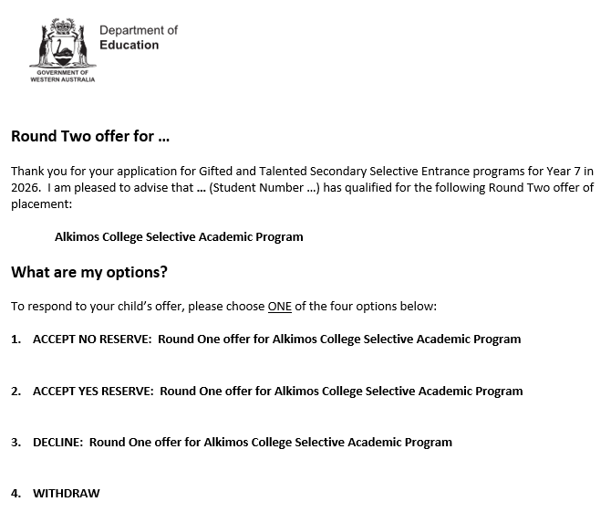
Programs
How to apply
Testing processes
Results
Offers of placement
Key dates
Round 2 Offer of Placement
Round 2 offers cannot be put on HOLD
Notes:
Update graphic

Slide 57
Programs
How to apply
Testing processes
Results
Offers of placement
Key dates
Enrolling at the school
If you ACCEPT an offer of placement you will be required to enrol at the school
If you do not enrol or cannot meet enrolment criteria by the stated deadline, the offer will be withdrawn
This also applies for families who ACCEPT YES RESERVE

Slide 58
Programs
How to apply
Testing processes
Results
Offers of placement
Key dates
Reserve lists and Reserve Round offers
All children who did not receive an offer of placement in round one or two will receive an unsuccessful notification early August
Children who receive an unsuccessful notice will be automatically placed on Reserve Lists for their preferences – if they meet the eligibility requirements
  Academic program reserve list eligibility will vary
  Arts and Languages eligibility requires the child having progressed to the interview stage
All Reserve List offers will be made by email. You will have two working days to respond
Only families who receive an offer of placement will be contacted
Reserve Lists will close on 1 December 2025 – no more offers for 2026. Vacancies becoming available after this time will go into the Year 9 intake pool for 2028

Slide 59
Programs
How to apply
Testing processes
Results
Offers of placement
Key dates
Key dates to remember
Applications close 11.59pm Sunday, 9 February 2025
Adjusted conditions testing and ASET exemption requests close Monday, 17 February 2025
Metro, Bunbury and Albany standard testing of Year 6 students will occur on Saturday, 15 March.
Metro, Bunbury and Albany standard testing of Year 8, 9 and 10 students will occur on Sunday, 16 March.
Regional WA outside of Bunbury and Albany testing of all year groups will occur 17-18 March.
Arts testing occurs throughout Term 1
Arts and Languages interviews will occur in Term 2
ASET Performance reports emailed early June
Offers will commence late June
All reserve lists close 1 December

Slide 60
APPLICATIONS NOW OPEN ONLINE
      Web: www.education.wa.edu.au/giftedandtalented
      Email: gtsu@education.wa.edu.au
      Phone: 9264 4307

